Slide 1
CS 61A Discussion 2
Jason Goodman
Pronouns: He/him
jasonpgoodman@berkeley.edu
Lab 111L: Tu 9:30-11 a.m., Soda 271
Disc 139: Th 9:30-11 a.m., Hearst Field Annex B1

Slide 2
Announcements
Hog due tonight by 11:59 p.m., HW2 & Lab 2 due Friday 2/8 at 11:59 p.m.
Midterm this Monday 2/11
Study hard, but please also take care of yourself and get adequate rest
Please make sure to practice past exams and check the Piazza threads if you get stuck
HKN review session Saturday 2/9 12-3 p.m. in HP Auditorium
CSM review session Sunday 2/10 2-4 p.m. in GPB 100
CSM section sign-ups now open and highly recommended
My office hours are today from 2-3 p.m. in 109 Morgan, but you are welcome to attend any office hours listed at cs61a.org/office-hours
Please also feel free to email me with any questions/concerns, and I will get back to you within 24 hours!

Slide 3
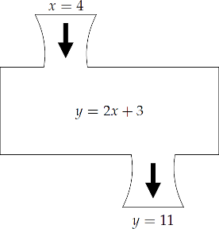
Higher Order Functions Analogy
f = x ** 2
g = 2 * f(x) + 3
g = 2 * (x ** 2) + 3
Notes:
Higher order functions are like feeding machines with machines. Machines are both inputs and the outputs
Here, you can see we have one machine or function that square some input i and we pass it into another machine that doubles some input x and adds 3
The result is another machine or function that squares our input, doubles the squared input and then adds 3

Slide 4
Higher Order Functions Analogy
f = x ** 2
def f(x): return x**2
def g(f, x): return 2 * f(x) + 3
g = 2 * f(x) + 3
g = 2 * (x ** 2) + 3
Notes:
Higher order functions are like feeding machines with machines. Machines are both inputs and the outputs
Here, you can see we have one machine or function that square some input i and we pass it into another machine that doubles some input x and adds 3
The result is another machine or function that squares our input, doubles the squared input and then adds 3

Slide 5
Higher-Order Functions
All functions (incl. higher-order functions) have two parts:
Code
A parent frame
Example
Remember: the parent of a function is the frame in which it was defined
In the example, the parent of h is frame 1 since it is defined when compose1 is called
A change in parent frame is the only thing that distinguishes “functions within functions”
Notes:
While we represent a function’s code by the “intrinsic name” / line number on an environment diagram, it really is the written lines of code that are the function

Slide 6
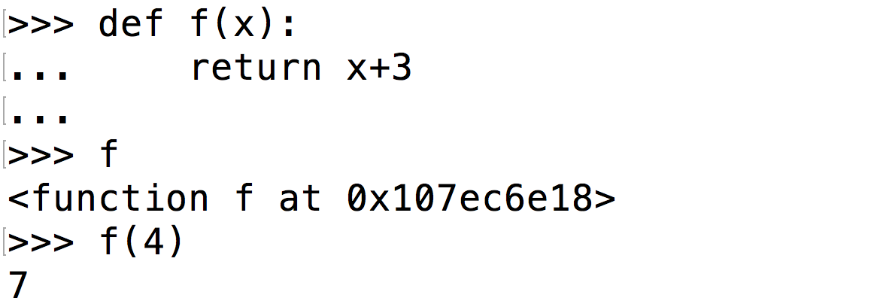
Higher-Order Functions
It is important to know the difference between functions and function values
Functions do not evaluate to their return value
Function calls do not (necessarily) evaluate to a function

Slide 7
Higher-Order Functions
Higher order functions that return a function have their return value represented with a pointer to the function object
Notice the return value of compose1 in the previous example

Slide 8
Lambda Expressions Example
Lambda expressions example
def statements example

Slide 9
Final Announcements
If you are new to my discussion and/or have not yet filled out my intro survey, please do so here: links.cs61a.org/139-intro
If you have any feedback regarding today’s section and how I can improve to best help you, please feel free to fill out this anonymous form: links.cs61a.org/139-fb

Slide 10
Appendix

Slide 11
Additional Resources
For additional information on higher-order functions and lambda expressions, please refer to the lab 2 slides
Also pop over to the CS 61A resources page

